Slide 1
Intelligent Use of Buildings’ Energy Information
Contents:
Short on IntUBE
Context
Concept
Technology
Coming next
Régis DECORME, CSTB
Stephan SCHÜLE, University of Stuttgart
GREEMBED 2010 Workshop
12th April 2010 – Stockholm, Sweden

Slide 2



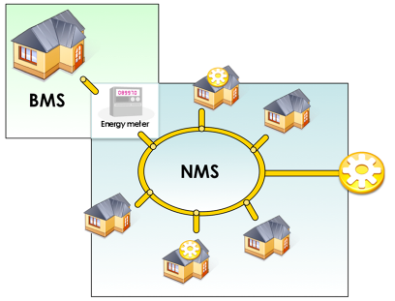
Short on IntUBE
FP7 co-funded STREP project
Contract n°224286
IntUBE
Intelligent Use of Buildings’ Energy information
IntUBE will lead to
  increased life-cycle energy efficiency of the buildings without compromising the comfort or performance of the buildings
    by integrating the latest developments in ICT-field into Intelligent Building and Neighbourhood Management Systems (IBMS and NMS) and
    by presenting new ICT-enabled business models for energy-information related service provision

Slide 3
Short on IntUBE

Slide 4
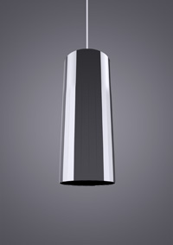

The challenge: context
Energy awareness
Flower lamp, Interactive Institute, Sweden

Slide 5


The challenge: context
Online information sharing
A social network for energy ?

Slide 6

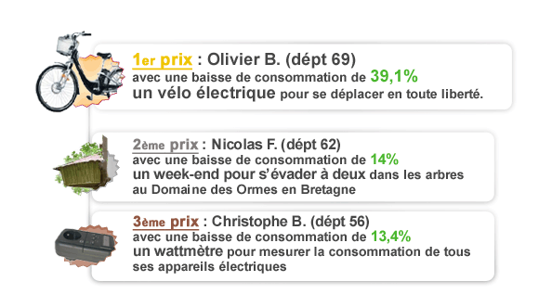
The challenge: context
Energy consumption benchmarking
Energy efficiency challenge launched by Poweo, French alternative energy provider
http://www.poweo.fr

Slide 7
The challenge: context
Energy management within office buildings
  Service sector is usually very wasteful with energy
    high amounts of energy use
    low levels of efficiency
  Employees rarely have a good understanding of and interest in energy efficiency

Slide 8
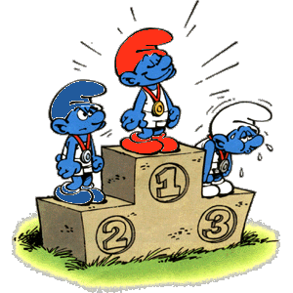
The challenge: concept
An intelligent use of buildings’ energy information through an energy competition
  Organize an energy challenge within office buildings to:
    Increase eco-behaviours and eco-attitude
    Improve the use of office equipments
    Reduce energy consumptions

Slide 9


The challenge: concept
Use of ICTs for accurate monitoring
  Individual energy consumptions
  Activity monitoring
    Bonus / penalty system
A win-win challenge
  Reward for the employees
  Energy savings for the company

Slide 10
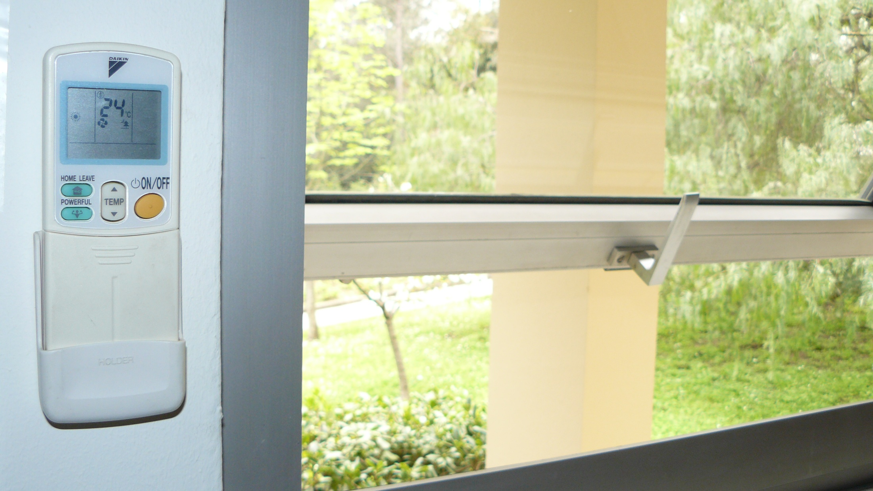
The challenge: Bonus or penalty ?

Slide 11
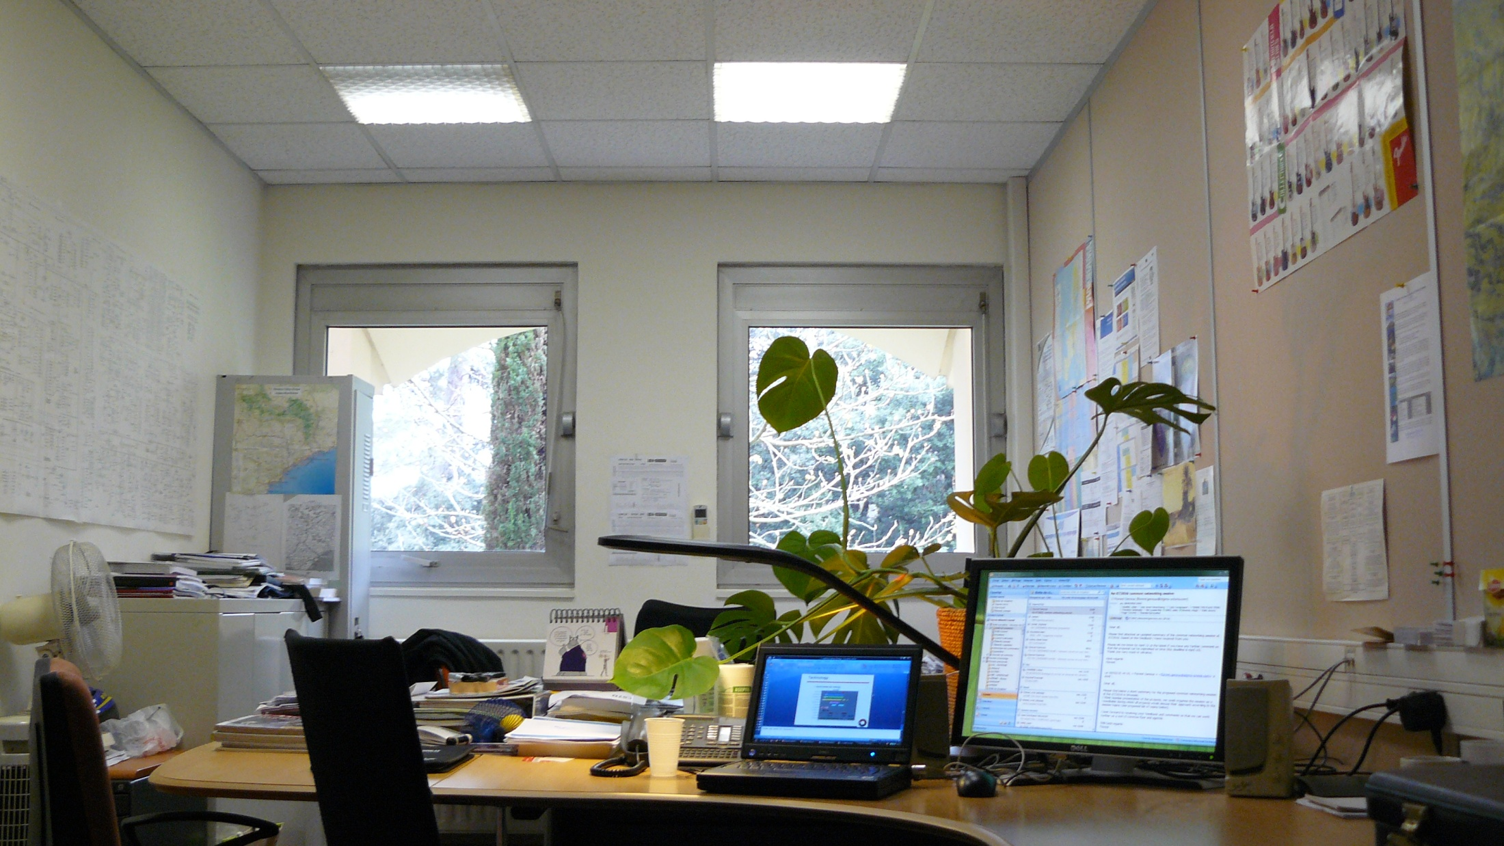
The challenge: Bonus or penalty ?

Slide 12
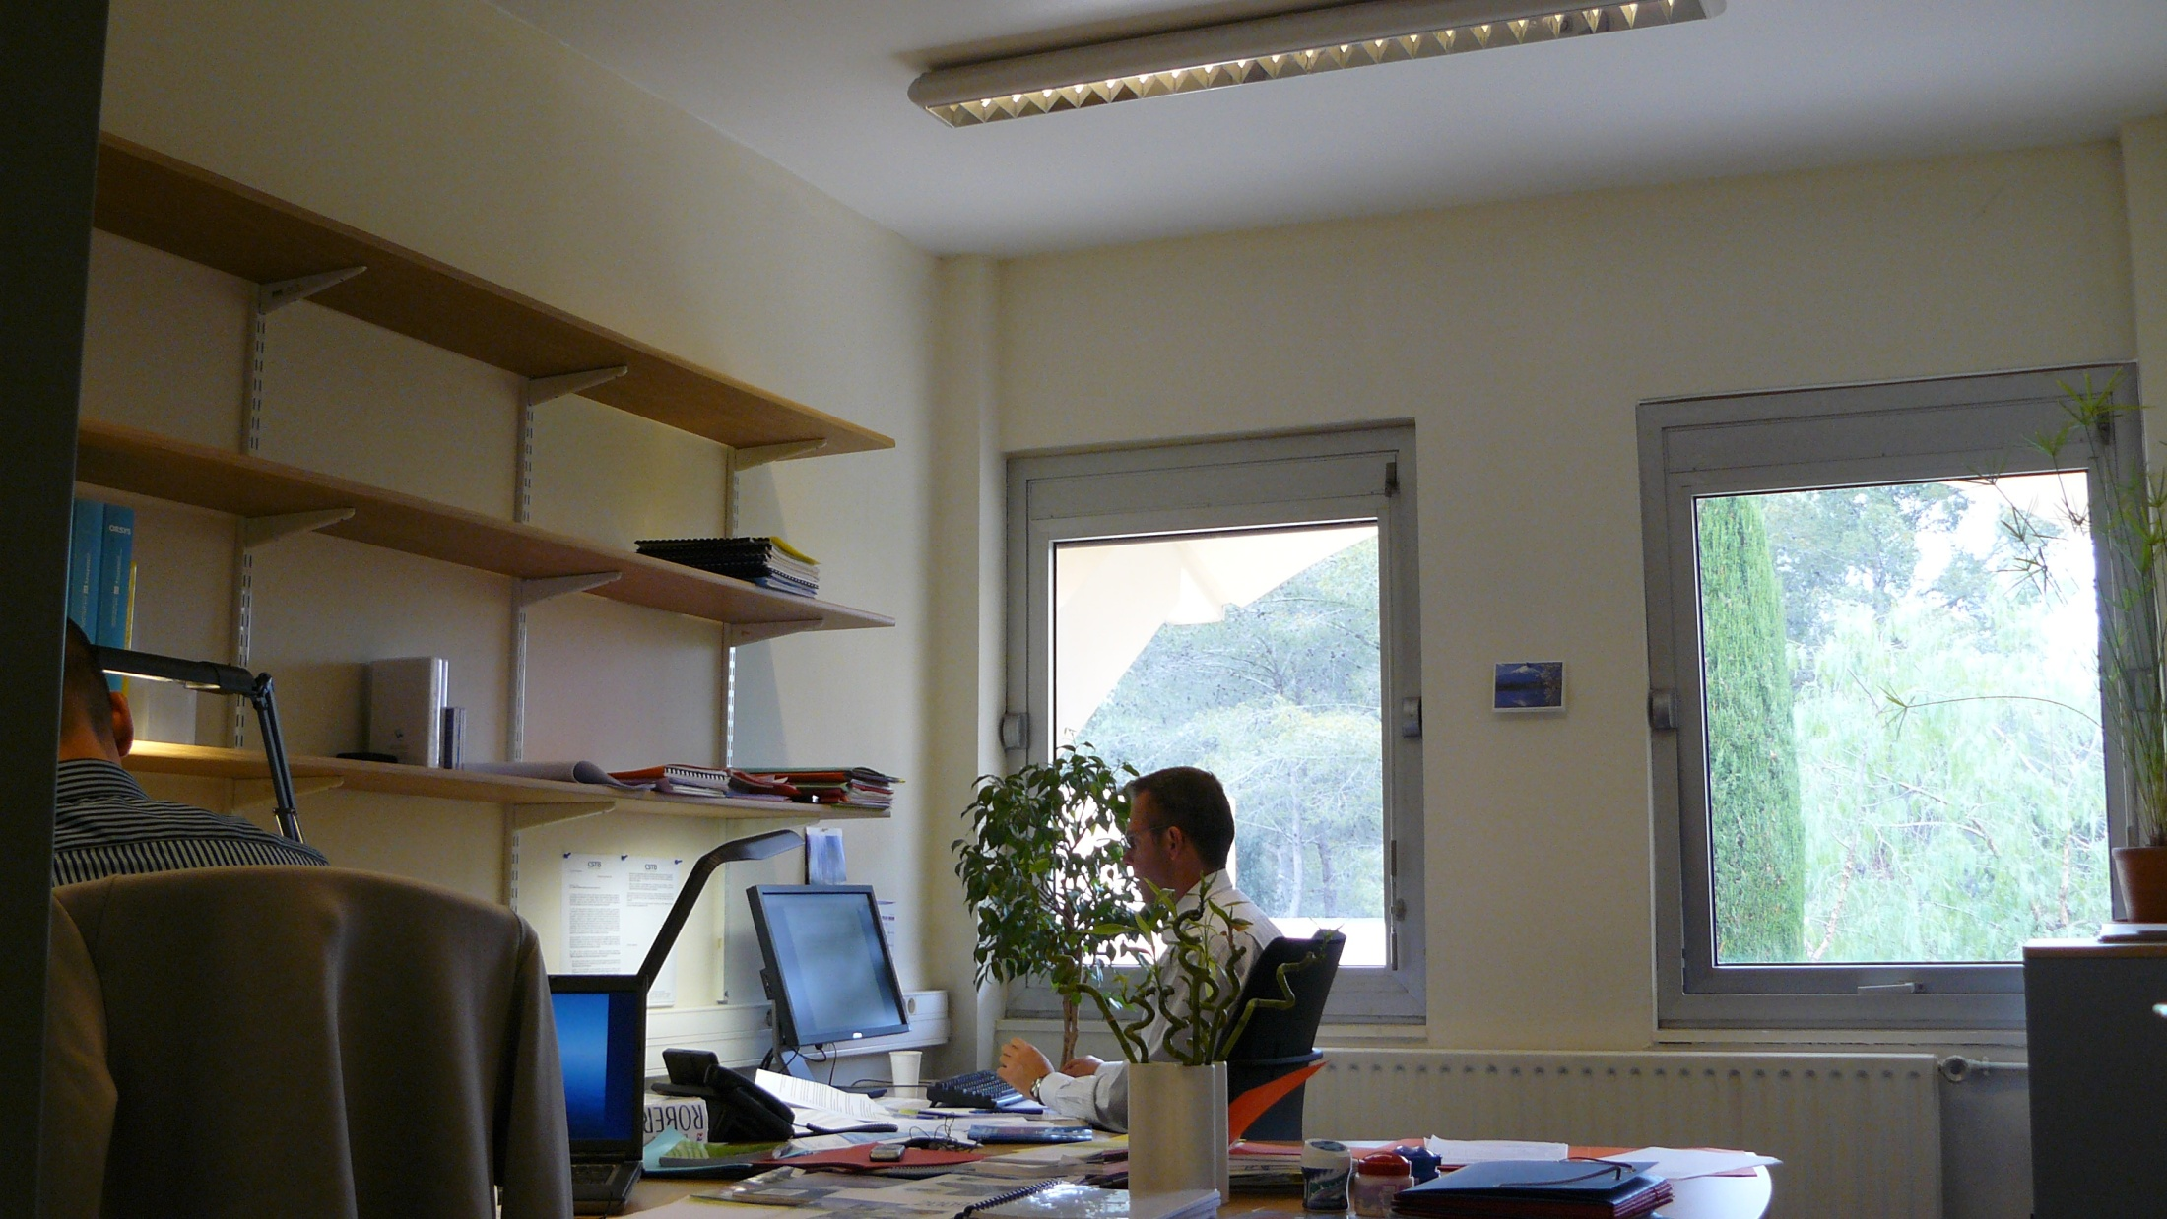
The challenge: Bonus or penalty ?

Slide 13
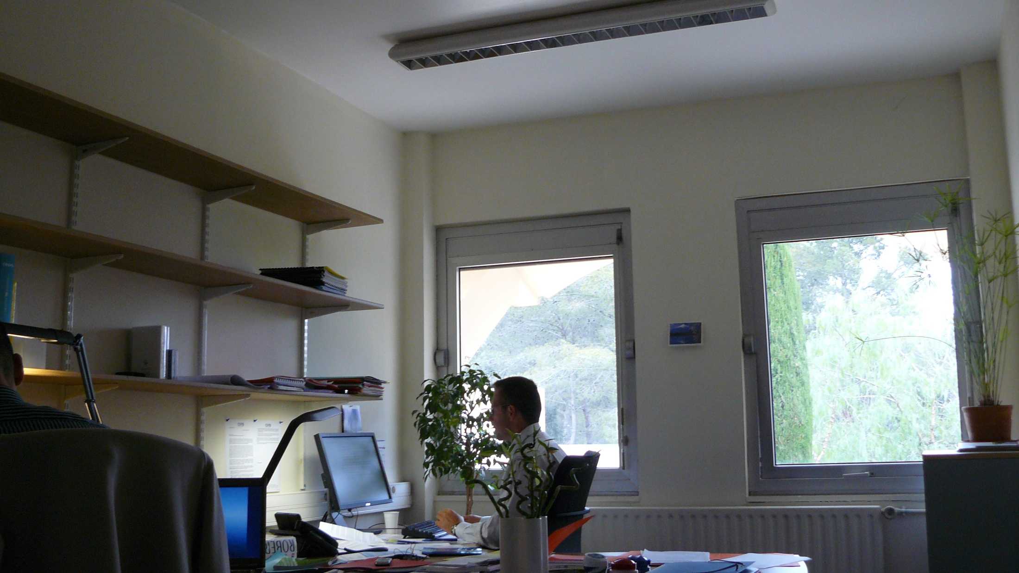
The challenge: Bonus or penalty ?

Slide 14
The challenge: bonus / penalty
Some examples of what will be monitored through ICTs
✗
✓
having a window open while the heating system is on
leaving the office at the end of the day with the computer switched on
switch on the artificial light while day light is sufficient
Having a temperature lower than 26° with the air-conditioning on
…
Switch off the light each time when leaving the office
Switch off your computer when leaving the office for more than one hour
…

Slide 15
The challenge: objectives & impact
Economical objectives:
  Money savings thanks to energy savings
Technical objectives:
  Building dynamic energy monitoring
  Knowledge on actual consumptions
Social objectives:
  Employees become actors of energy efficiency
  Stimulate long-lasting environmental-friendly behaviours

Slide 16
The challenge: technology
Functionalities
  Measure offices and devices consumptions
  « Measure » users’ behaviours
Needed ICTs
  Smart meters/sub-meters for detailed and real-time energy consumption monitoring
  Wireless sensors for detecting “energy-impacting” behaviours
  ICT-based displays for energy awareness
  ICT platform for energy consumption data storage and benchmarking

Slide 17
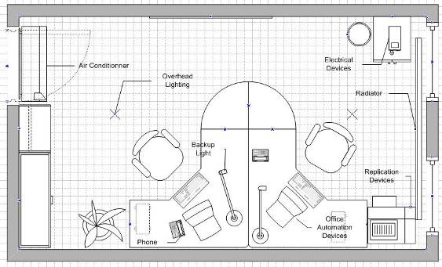
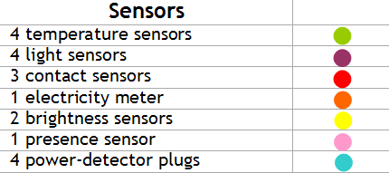
The challenge: technology
Equipment of one office room for testing purposes

Slide 18
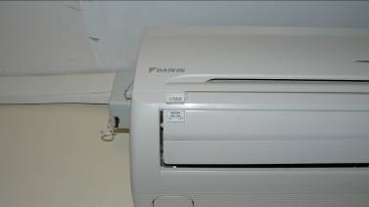
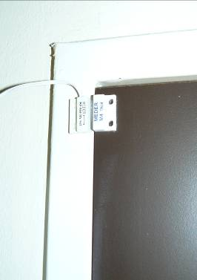
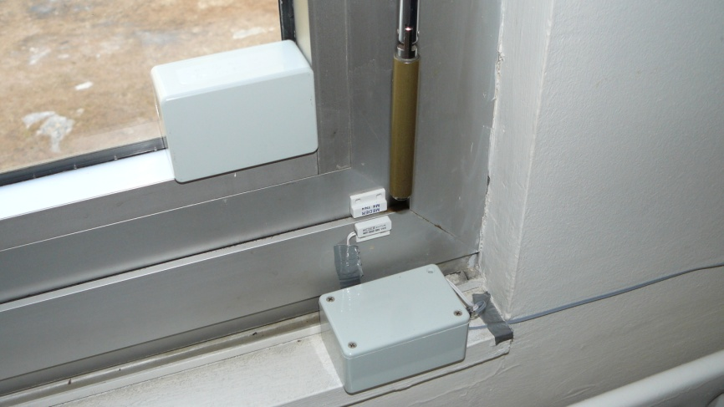
The challenge: technology
Contact sensors
Air-conditioning
Door
Windows

Slide 19
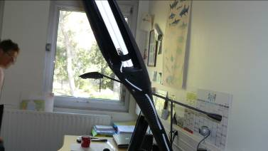
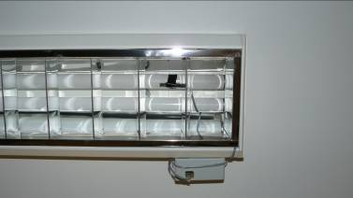
The challenge: technology
Brightness sensors
Backup light
Outdoor brightness (window)
Overhead lighting

Slide 20
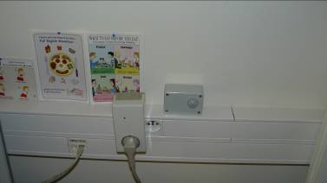
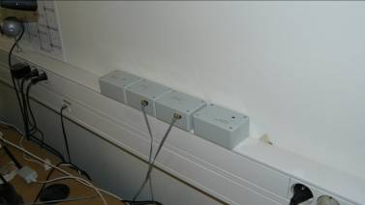
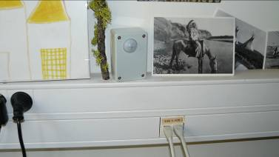
The challenge: technology
Power-detector plug
Temperature sensor
Use of electrical equipments
Presence sensor

Slide 21
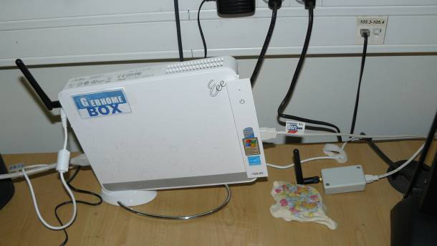
The challenge: technology
Data concentrator xBee (CSTBox)

Slide 22
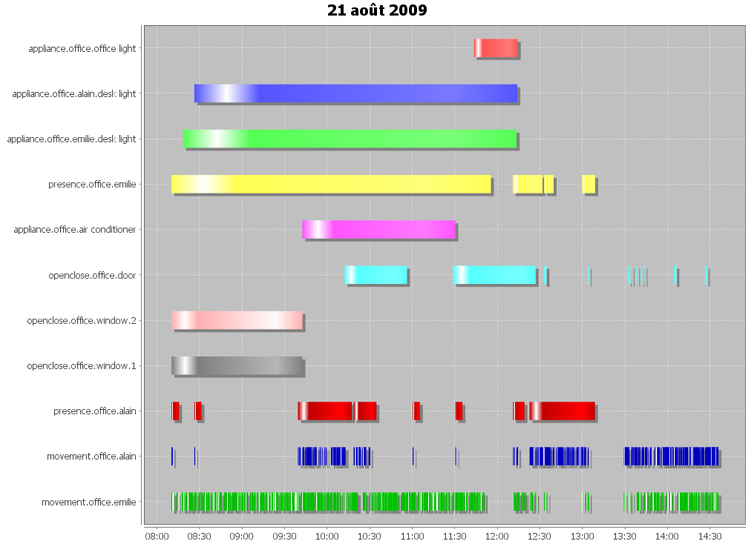
The challenge: technology
Event viewer (for testing)

Slide 23

The challenge: technology
Bonus/malus log analyzer
void evaluate_windows_and_air_conditionner(states, context) {
def ID = "WND_OP.and.AC_ON" ;
if (states.windows_opened && states.air_conditionner_on) {
startMalus(ID, context.event.timestamp) ;
} else {
endBonusMalus(ID, context.event.timestamp) ;
}
}

Slide 24
The challenge: technology
User interface (challenge participant)
  The challenge: presentation, its objectives and rules
  Green tips
  Energy consumption (myself / my team / all)
    Current week
    Records (graphical form, trends)
  Number of bonus / malus records (myself / my team / all)
    Current week
    Records (graphical form, trends)
  Records of behaviours responsible for bonus / malus
  Energy savings estimate (myself / my team / all)
  Team ranking
    Live, history, trends
Email notifications (daily – weekly)

Slide 25





Coming next …
The energy challenge …
… for real !

Slide 26
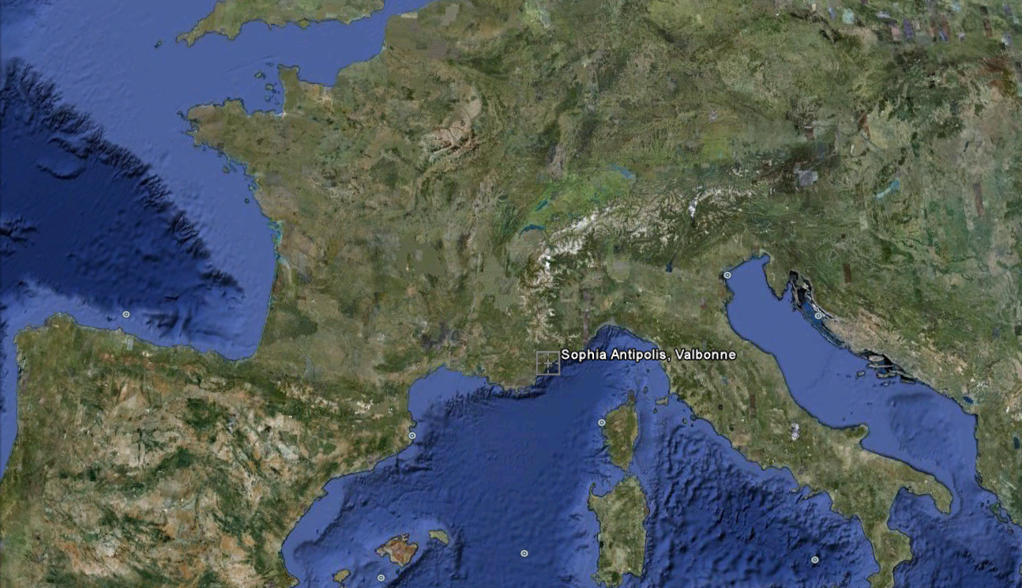
Ecoffices : where ?
User interface (challenge participant)
  Content :

Slide 27
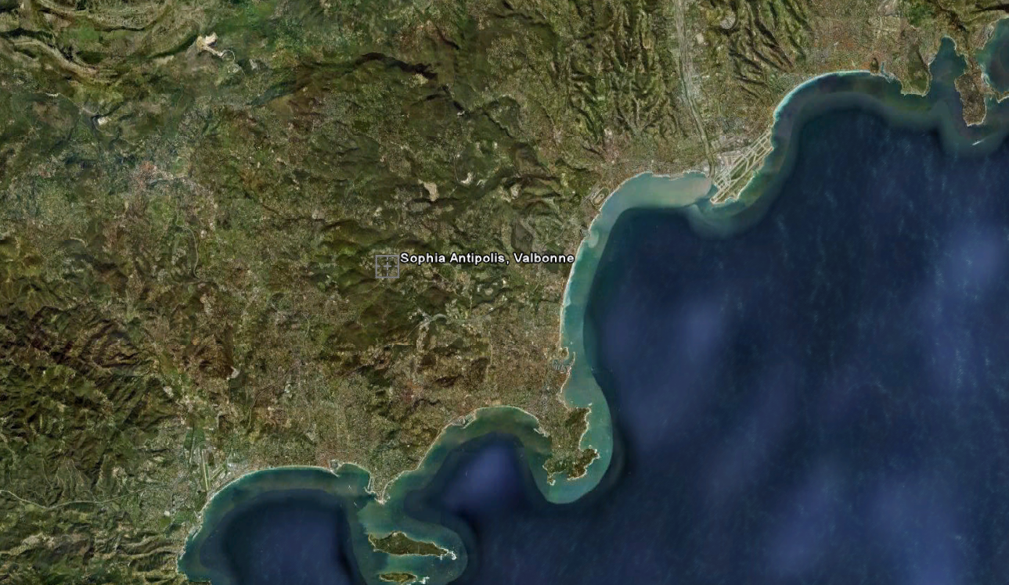
Ecoffices : where ?
User interface (challenge participant)
  Content :

Slide 28
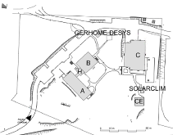
Ecoffices : the pilot
  CSTB office buildings
    Sophia-Antipolis
    Building A-H-B
    45 office rooms
    1640 m²
  57 employees
    Divided into 3 teams
  Starting date
    September 2010

Slide 29
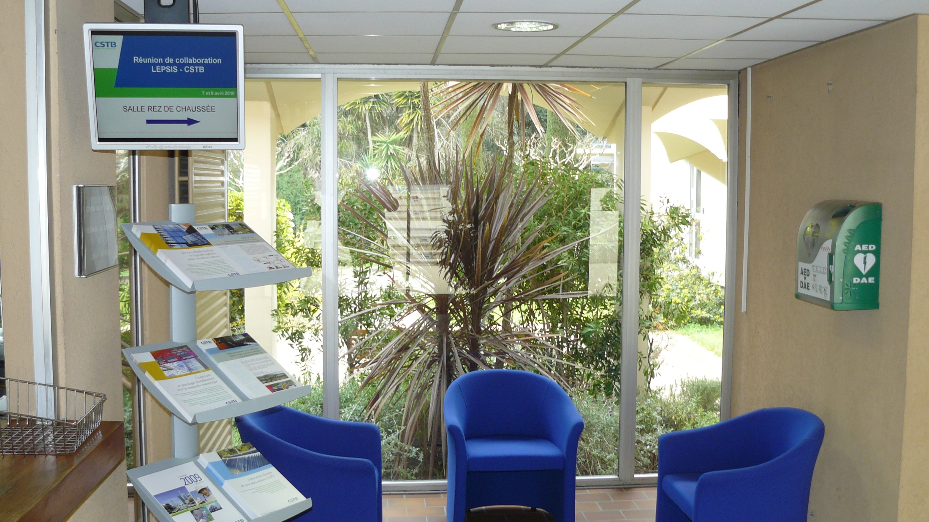
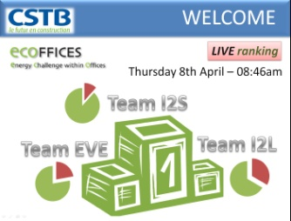
Ecoffices : reception desk

Slide 30
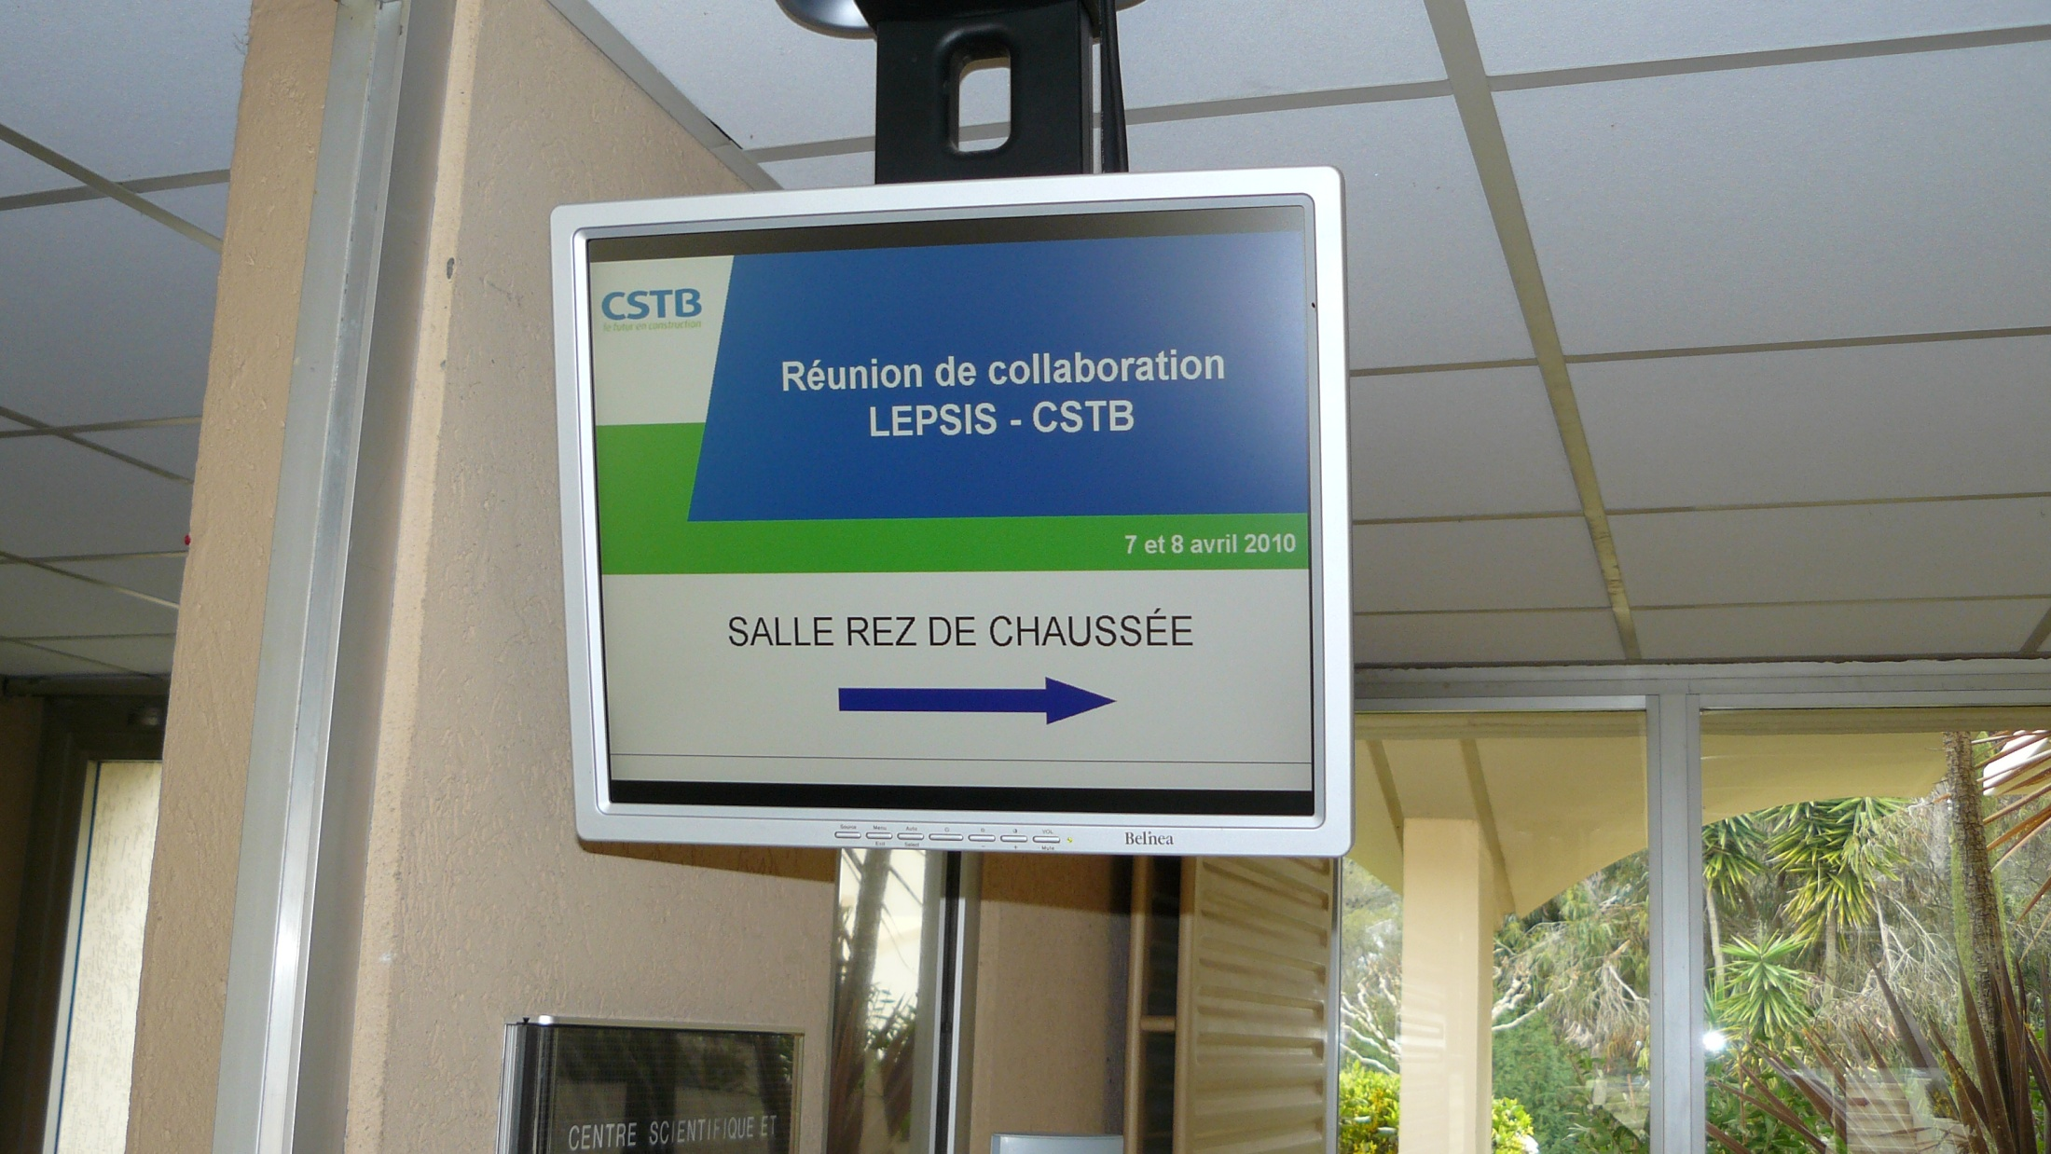
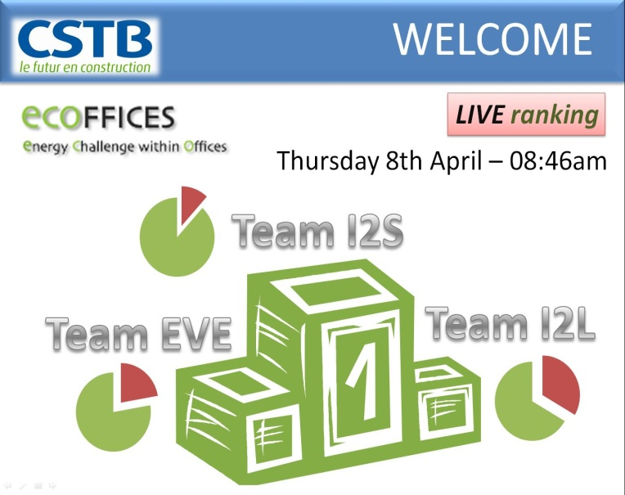
Ecoffices : reception desk

Slide 31
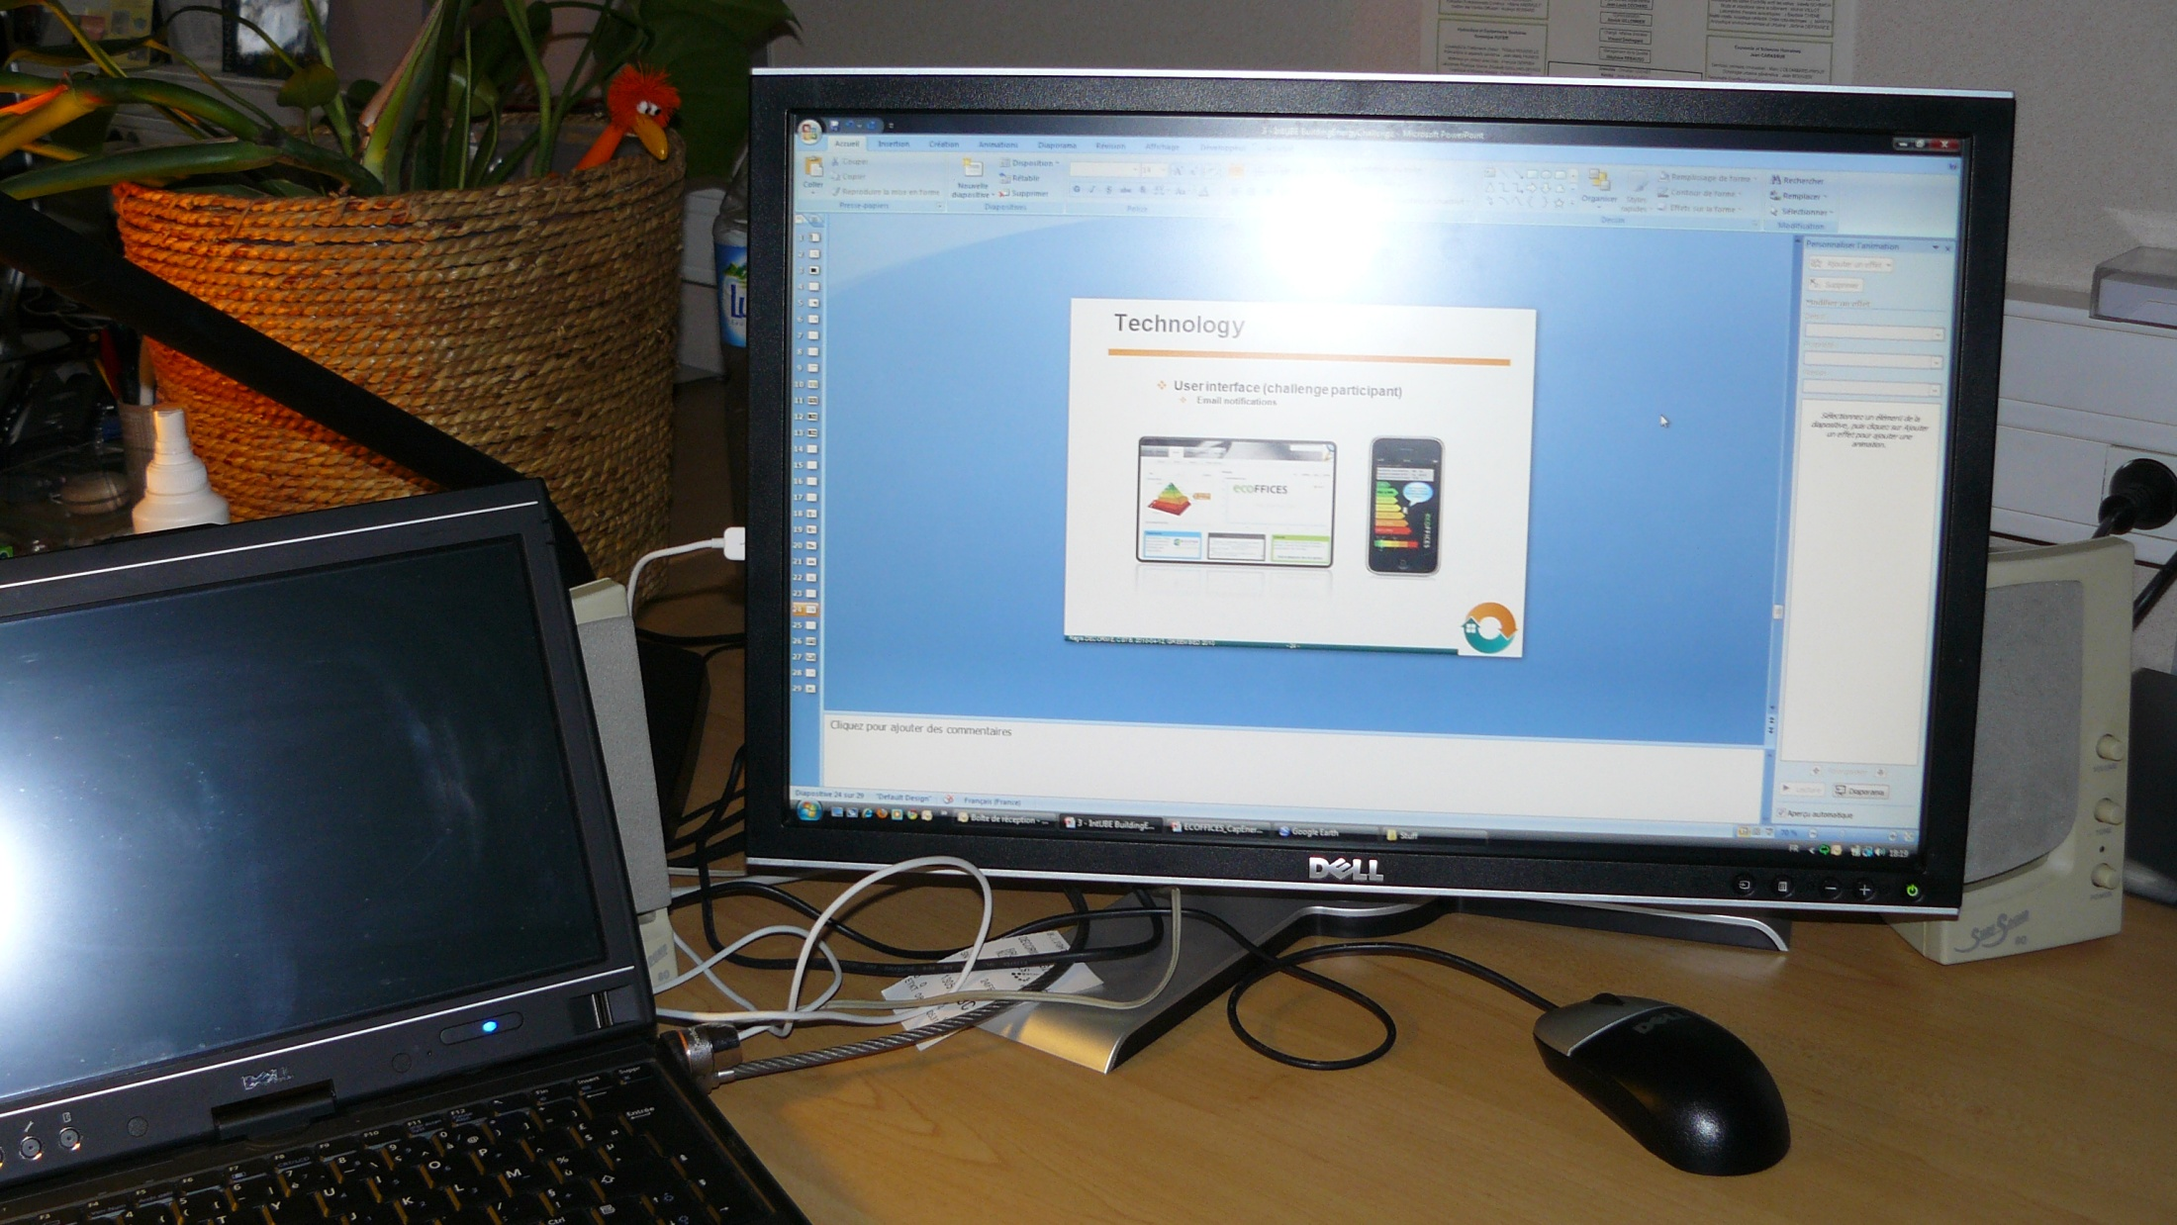
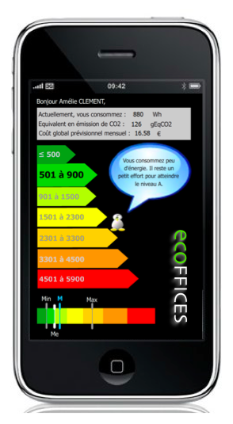
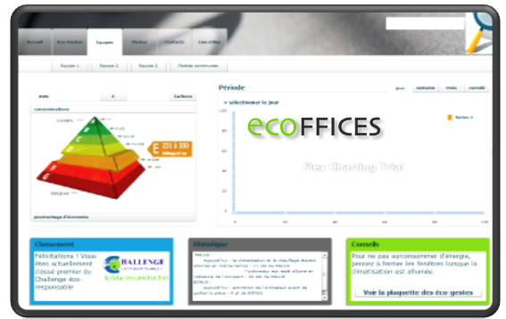
Ecoffices : workstation
User interface (challenge participant)
  Email notifications

Slide 32
Ecoffices : stages
2 month
6 month
2 month
1
2
3
Stage 1
“User interface”
All offices monitored
2 groups: only one group equipped with the user interface
Stage 2
“Challenge”
All offices monitored
3 teams
All with access to the user interfaces
Stage 3
“Appropriation”
All offices monitored
All employees have access to the user interfaces

Slide 33
Thank you
Contact:
  regis.decorme@cstb.fr
  stephan.schuele@iat.uni-stuttgart.de
About IntUBE:
  http://www.intube.eu
  Join online the Community of Interest !
  Mia Ala-Juusela, VTT, Project manager
    mia.ala-juusela@vtt.fi
About ECOFFICES (soon)
  http://www.ecoffices.com
Grant agreement n° 224286

